Slide 1

Team 1
Interim Project
Cian, Cristiana, Hazel, Nina, Nonty

Slide 2










RESOURCES USED IN THIS PROJECT

Slide 3
Question 1
What are the regional sales in the best performing country?

Slide 4
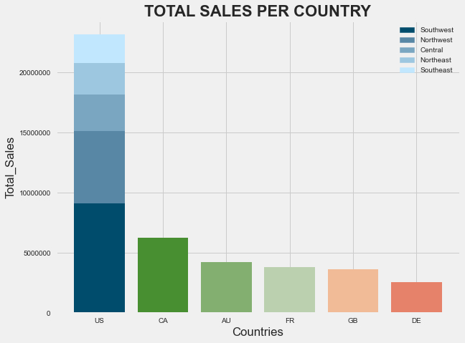
US is the only country that has stores in more than one region

Slide 5
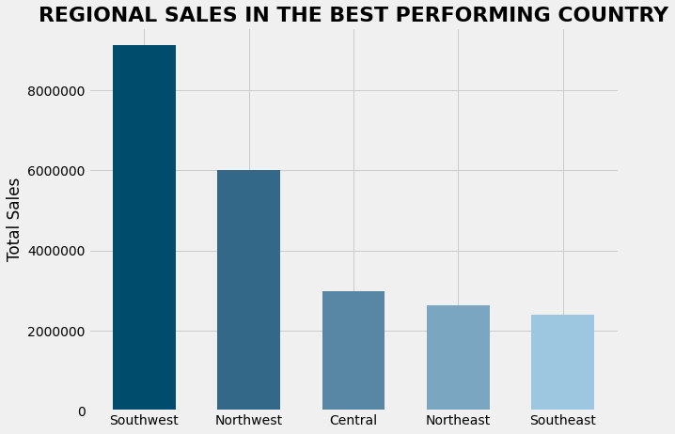
The Southwest and Northwest are the most profitable regions in the US
Notes:
I used the bar plot that, to illustrate all the regional sales in the best performing country. As you can see the southwest and Northwest are the most profitable regions in the US.

Slide 6
Question 2
What is the relationship between annual leave taken and bonus?

Slide 7
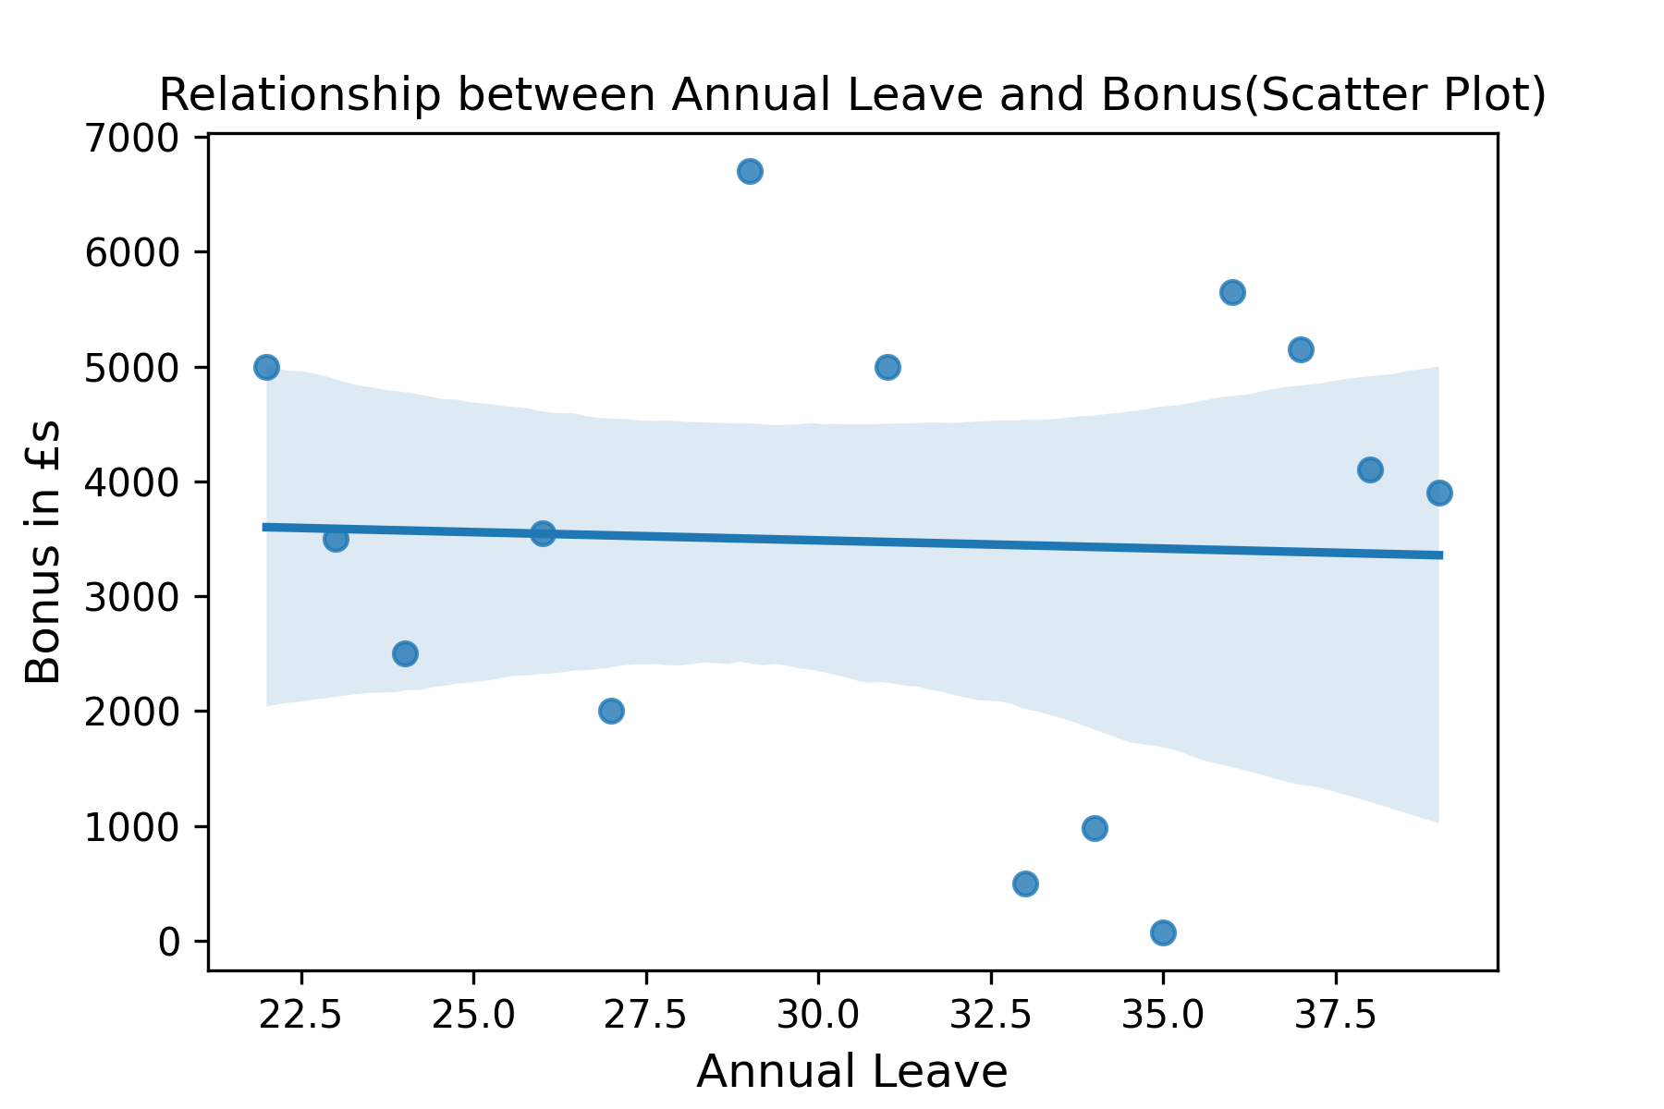
No pattern
Corr = -0.041
Regression line almost horizontal
Random data points e.g
Highest = £6,700.00 bonus for 29 hrs leave
Lowest = £500 bonus for 35 hrs leave

Slide 8
Conclusions
Hypothesis: “Employees who take more leave hours get less bonus as they work less”
There is no relationship between the annual leave taken and the bonus.

Slide 9
Question 3
What is the relationship between Country and Revenue?

Slide 10
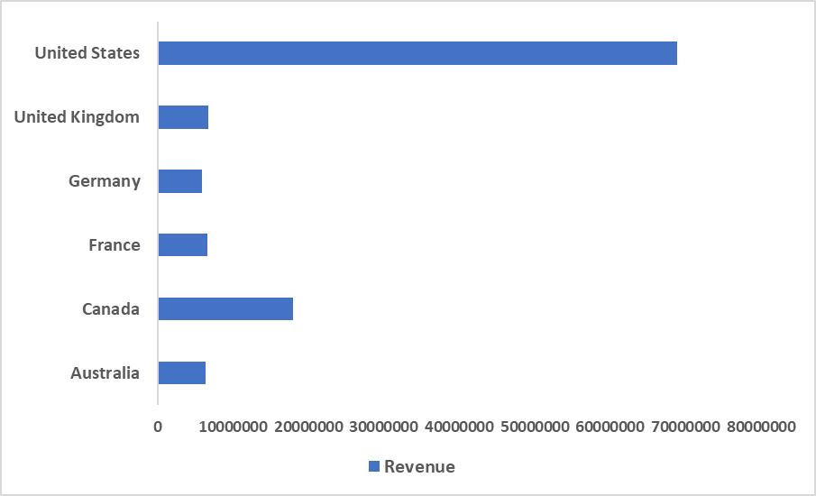
Relationship between the different countries and annual revenue generated for each

Slide 11
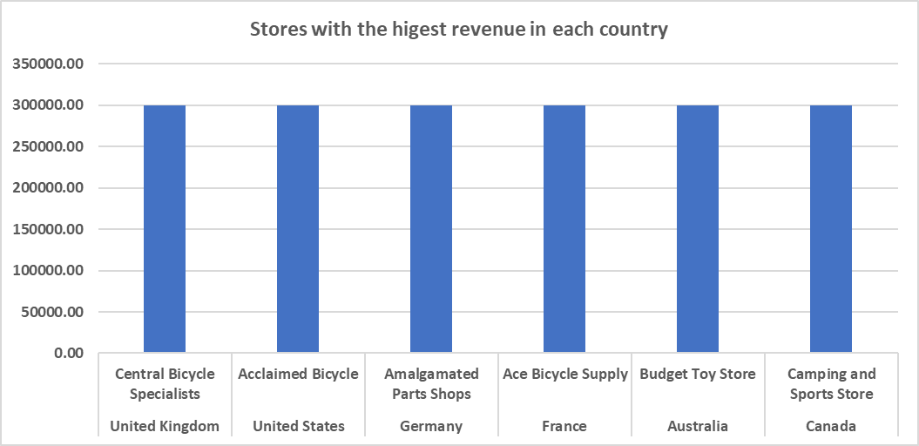

Slide 12
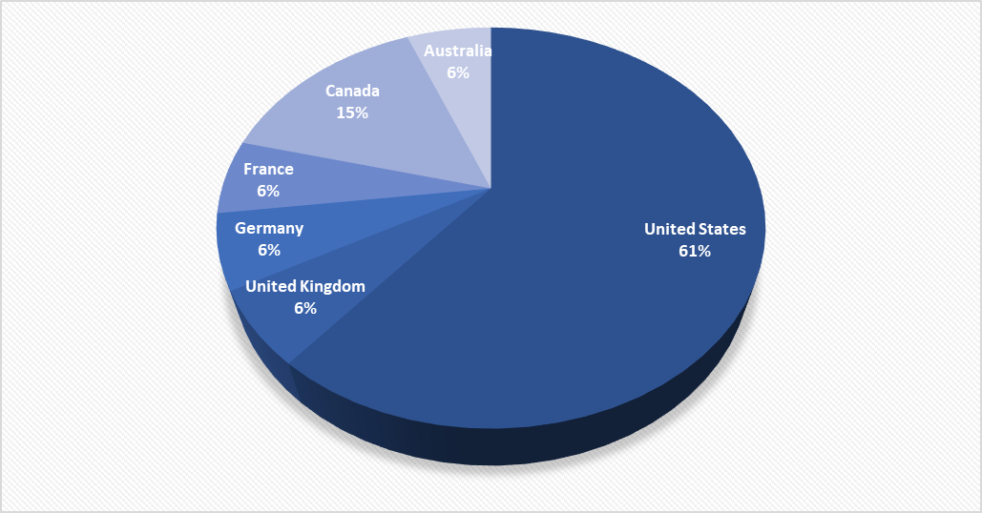
Percentage of stores in each country
United States has 427 stores
Canada has 115 stores
Rest have 40 stores

Slide 13
Insights / Findings
The US was generating more annual revenue because of the amount of stores they have
It also shows that the countries are doing well sales
In future more stores could be opened in the different countries. Allowing for expansion

Slide 14
Question 4
What is the relationship between sick leave and Job Title?
Notes:
Relevant information (Job Title, Sick Leave Hours) found in HumanResources.Employee. Also joined HumanResources.Department for additional information on Job Department and Department Category

Slide 15
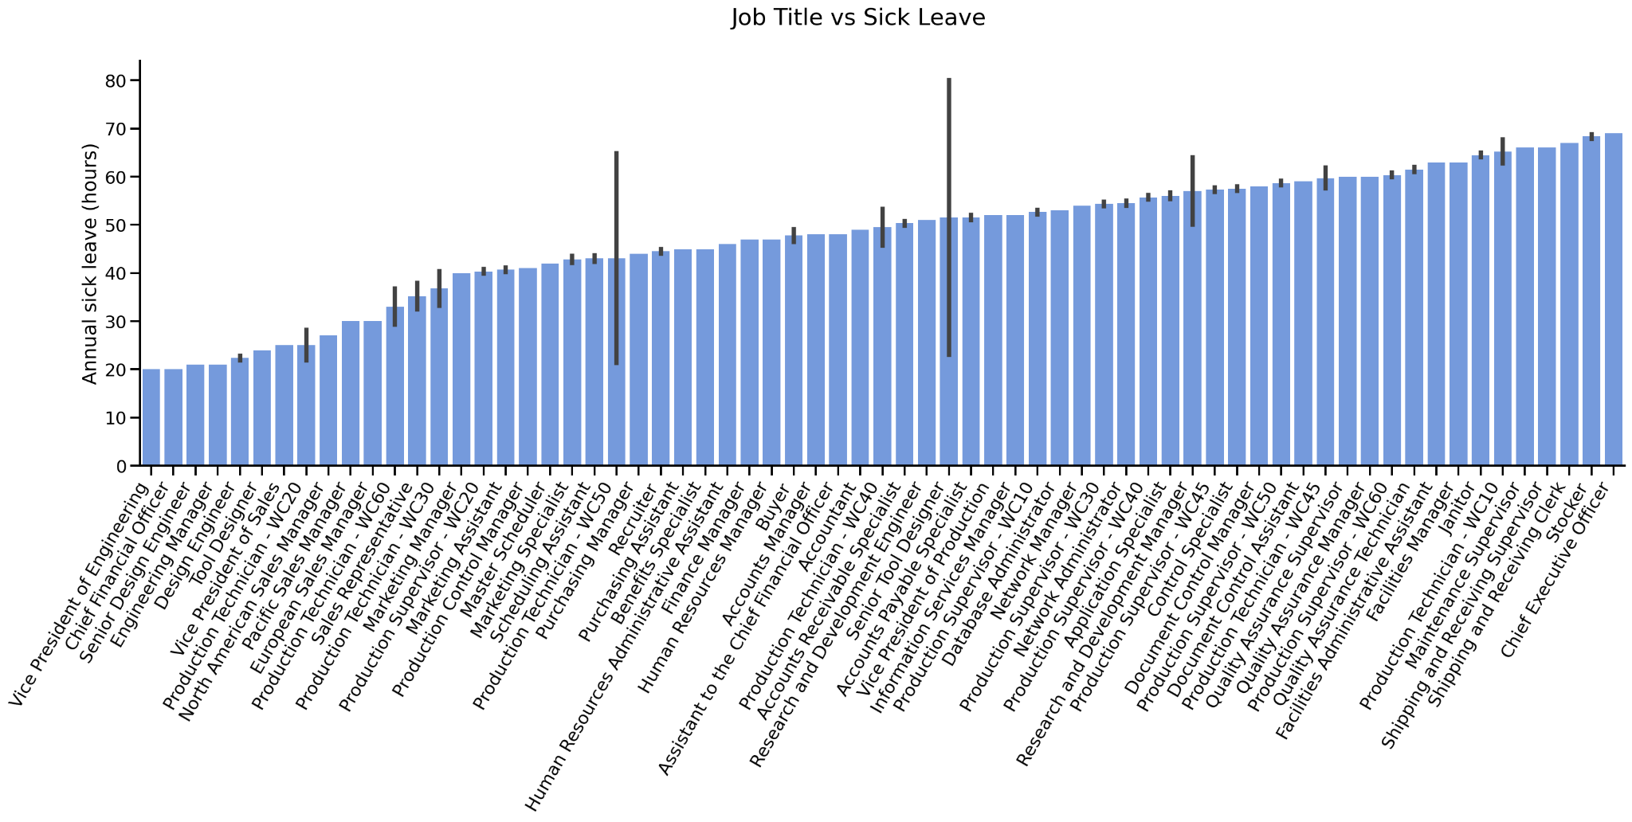
Average Sick Leave by Job Title
Notes:
There are 67 unique jobs at AdventureWorks
Of those, 28 are job titles held by only one person (42%)
There are only 10 job titles held by five or more people (15%)
Analysis by job title is too granular for useful statistical analysis
Two possible other divisions - Organisation Level and Job Department

Slide 16
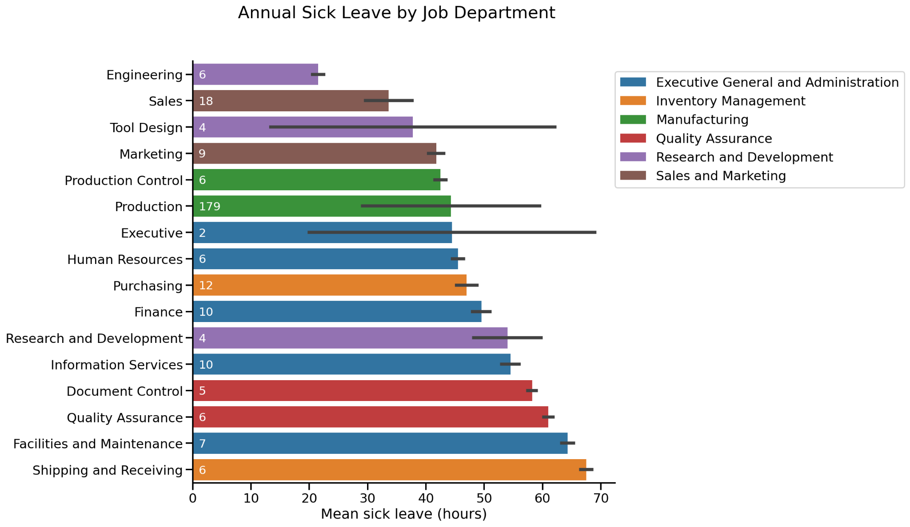
Bar length measures the mean
Line shows standard deviation
White label is group size

Slide 17
Organisation Structure
CEO
Ken
1
Terri
Jean
2
Griffin
Jenny
Matt
3
Gail
Pilar
Dylan
John
4
Cian
Cristiana
Hazel
Nina
Nonty

Slide 18
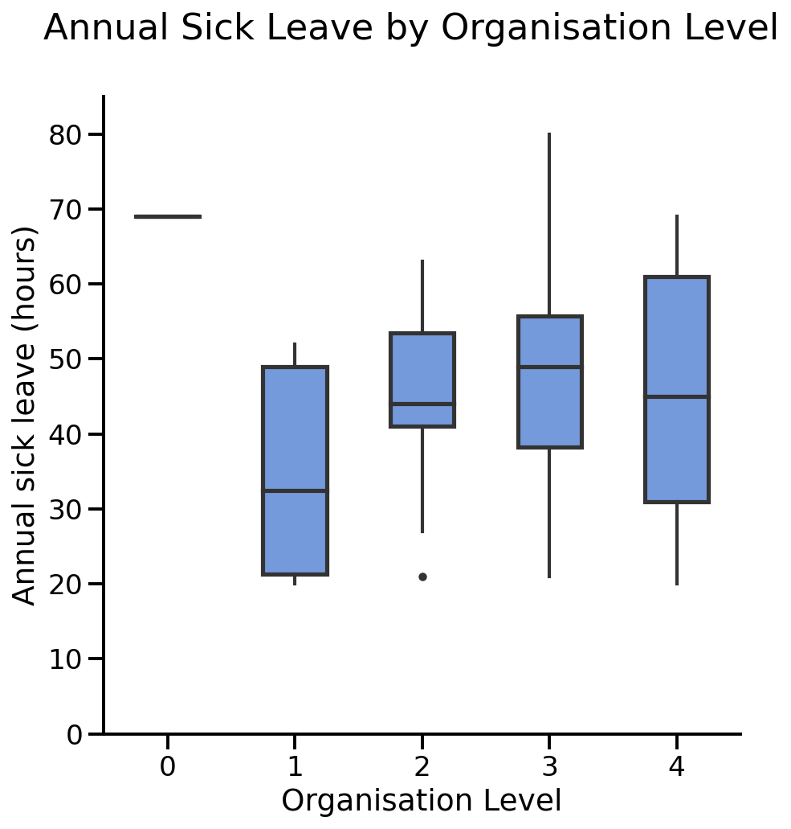
Notes:
Median sick leave peaks at Level 3, with 49 annual hours. Decreases to 44 at Level 2 and 32.5 at Level 1. CEO gets the good hours at 69
Median sick leave at Level 4 is 45 hours, but has a larger range and IQR than Level 2

Slide 19
Insights / Findings
Breakdown by job title is too granular for useful analysis, with only 10 job titles having 5 or more people
Job department is a strong predictor of annual sick leave for departments with more than 4 people
Median sick leave is highest at Level 3, decreases slightly at Level 2 and decreases significantly at Level 1

Slide 20
Question 5
What is the relationship between store trading duration and revenue?

Slide 21
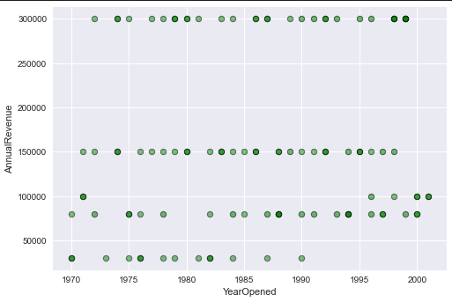
A scatter plot visualising the relationship between store trading duration and store revenue

Slide 22
Insights about store trading duration and store revenue:
There is no relationship to be found (graph is uncorrelated)
Points on the scatter plot with higher opacity illustrate a number of datapoints stacked on the same value
Stores opening year does not have an effect on annual sales, i.e a newly opened store can reach high revenue just as often as an existing one

Slide 23
Question 6
What is the relationship between store size, number of employees and revenue?
Notes:
Sales.vStoreWithDemographics view, which pulls and expands XML data from Sales.Store.Demographics column

Slide 24
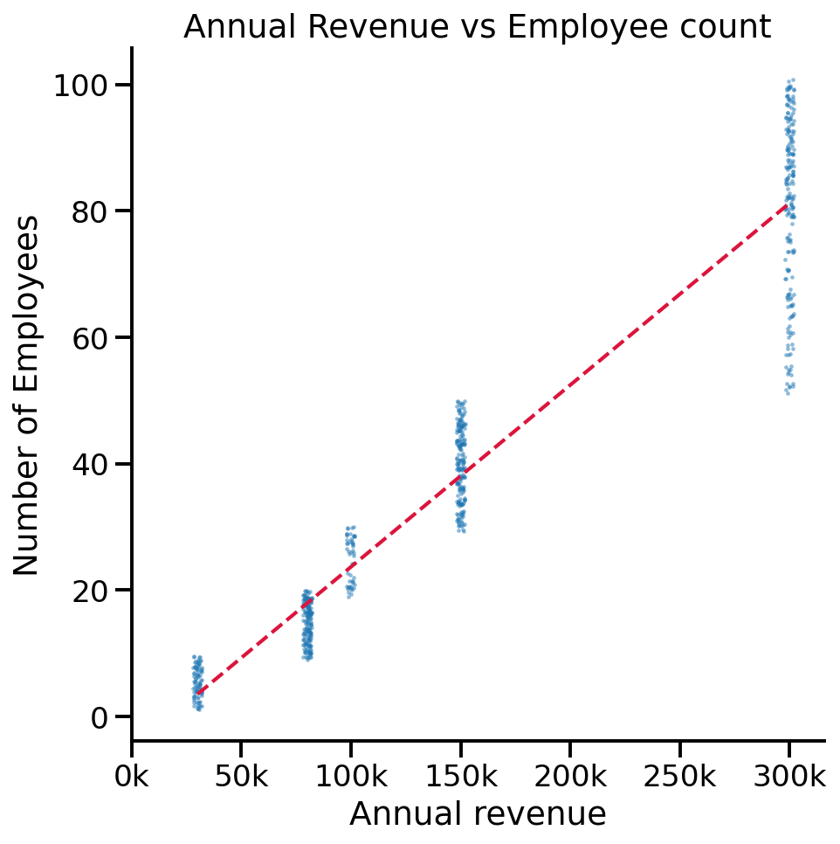
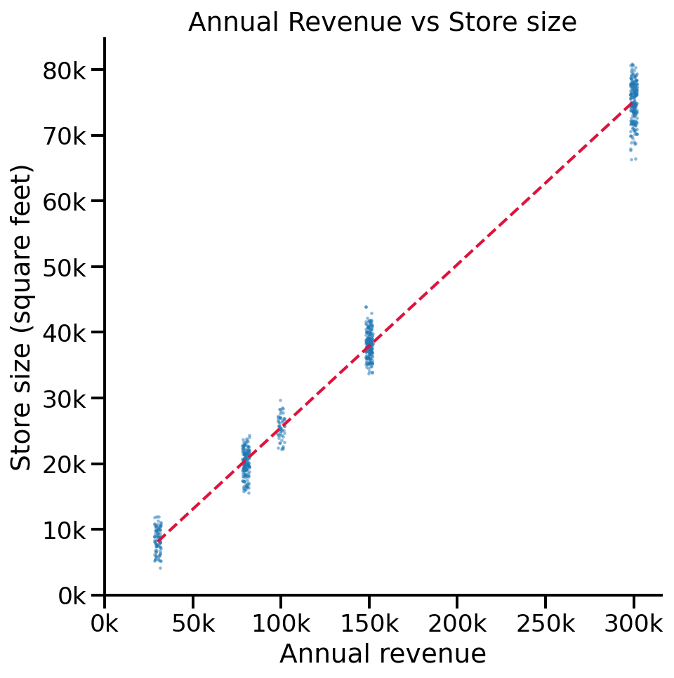
r = 0.958
Employee count = (Annual revenue × 0.000288) - 5
r = 0.997
Store size = (Annual revenue × 0.248) + 659
+50k annual revenue ≈ +14 employees
+50k annual revenue ≈ +12k square feet

Slide 25
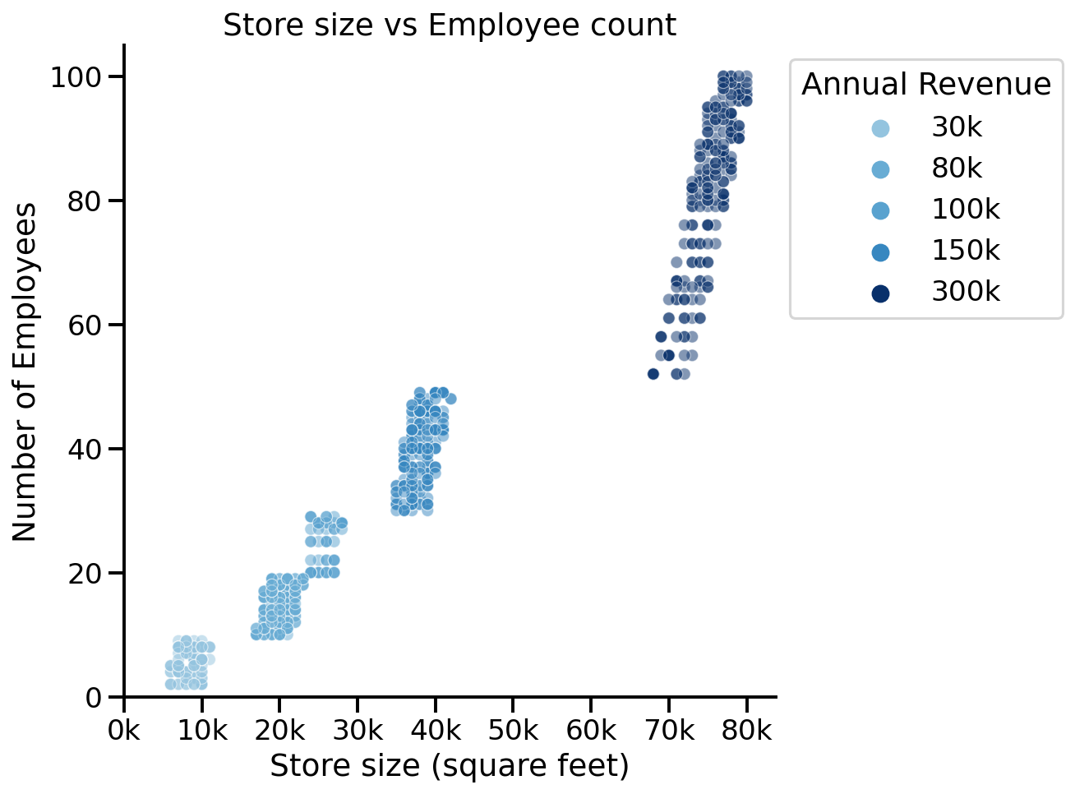
+10k square footage means approximately +12 employees
r = 0.971
Employee count = (Store size × 0.00117) - 6

Slide 26
Insights / Findings
Almost perfect positive linear relationships between all three variables
Correlation does not mean causation - it is impossible to tell from this analysis if an increase in one of the variables is causing the increase in another, or if they are both increasing in response to another unknown variable

Slide 27
Thank you for your time!
Any questions?

